Slide 1
"Black Arts" Index Maintenance #2
Better Methods that Can Actually Prevent Fragmentation for Weeks
Jeff Moden
SQL Saturday #830- Colorado Springs, CO
06 April, 2019

Slide 2
"Black Arts" Index Maintenance #2
Better Methods that Can Actually Prevent Fragmentation for Weeks
Jeff Moden
SQL Saturday #830- Colorado Springs, CO
06 April, 2019

Slide 3

Your Speaker – Jeff Moden
22 years experience working with SQL Server
Started out as an “Accidental DBA”
Mostly Self Taught
One of Leading Posters on SQLServerCentral.com
Member since 2003
More than 47,000 posts (heh… some are even useful)
33 articles on the “Black Arts” of T-SQL
Coined the term "RBAR" (Row By Agonizing Row)
Helped make the "Tally Table" a household name
9 Year SQL Server MVP Veteran
Winner of the Red Gate “Exceptional DBA” award for 2011
Frequent speaker at PASS Chapters and SQL Saturdays.
Lead Application and part-time systems DBA, Data Architect, and SQL Mentor for Proctor Financial, Inc.
SQL Server is both my profession and my hobby
(Yeah, I know… I STILL need to get a life ;-)

Slide 4
Special Thanks and Acknowledgement
Brent Ozar
https://www.brentozar.com/
Paul Randal and Kimberly Tripp
https://www.sqlskills.com/
Steve Jones and various SQL "Ninjas" too numerous to list
http://www.sqlservercentral.com/
Ed Wagner
Good friend and early adopter that has provided incredible feedback and insight.

Slide 5
Introduction

Slide 6
Pre-Requisites
The things that were taught in Session #1.
This is an "advanced" presentation and you should already know the following things.
What Clustered and Non-Clustered Row-Store Indexes are and what their structures are.
What a "page" is.
What a "page split" is.
What "Logical Fragmentation" is.
What "Physical Fragmentation" is.
How to use sys.dm_db_index_physical_stats.
What an Index REBUILD and REORGANIZE is and what the differences are.

Slide 7
In Session #1
Discovered that "Bad" Page Splits…
Cause performance problems.
Lots of data movement (50% or more of a page)
Done in a "system transaction".
Causes blocking.
Cause 4.5 to 43 times more log file writes.
Are the primary reason we do index maintenance.
REORGANIZE perpetuates the need for index maintenance.
Removes critical free space when we need it most!
That causes more page splits!
And that causes need for more defragmentation!
Takes a LOT longer than REBUILDs.

Slide 8
In Session #1
Logical Fragmentation
Only matters for "Read Ahead" performance!
Does NOT matter once data is in-memory!
Not doing index maintenance is better than REORGANIZE for the type of index we were working with!
Got a whiff of how to fix all that!
Virtually eliminates all page splits.
Even the "good" ones (which are still bad)!

Slide 9
Goals for Session #2
More on "Death by Defragmentation"
REORGANIZE is actually worse than we think.
More on the "DNA" of indexes.
"Insert Patterns"
Evenly Distributed
Static/Nearly Static
Append Only
Siloed (with 2 sub-types)
Unknown
Delete/Insert (Not covered in this session)
The Horror of "ExpAnsive Updates"
Recommendations
What I've Done
The Rules I follow and how I implemented.
There will always be an exception.
There is no 100% Panacea ("Must Look Eye")

Slide 10
Low Threshold Rebuilds
as Seen by sp_IndexDNA

Slide 11
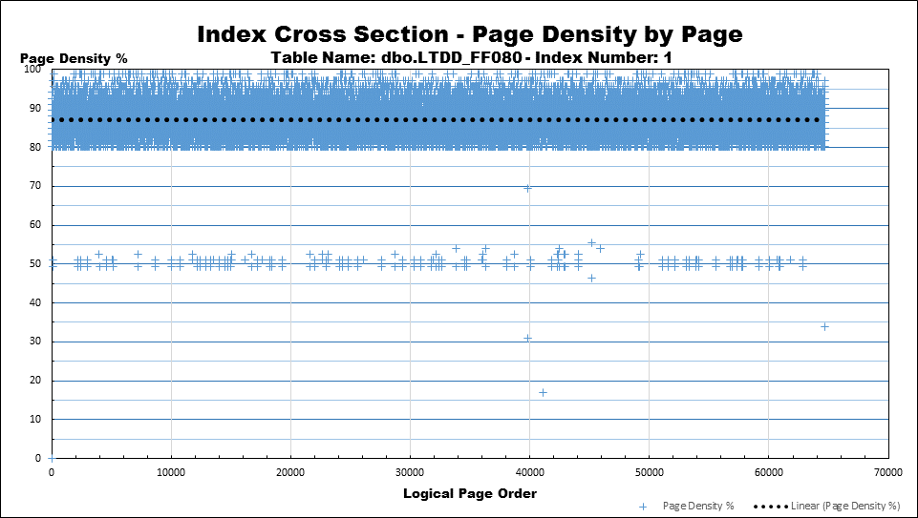
Low Threshold Rebuilds Daily 80 Random GUID/Evenly Distributed
Almost everything above 80% line.
Average Page Density is ~87%
Filling in above FF line as expected.
Just starting to fragment and will rebuild before it gets much worse.
Had no page splits/fragmentation for 4 weeks

Slide 12
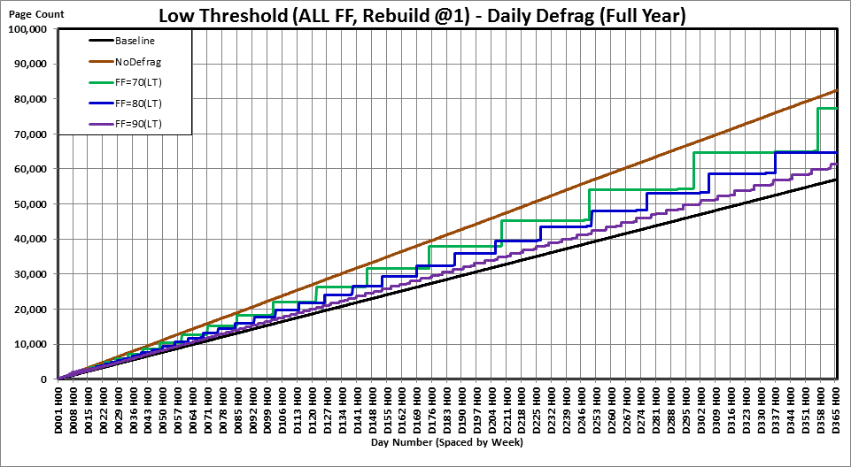
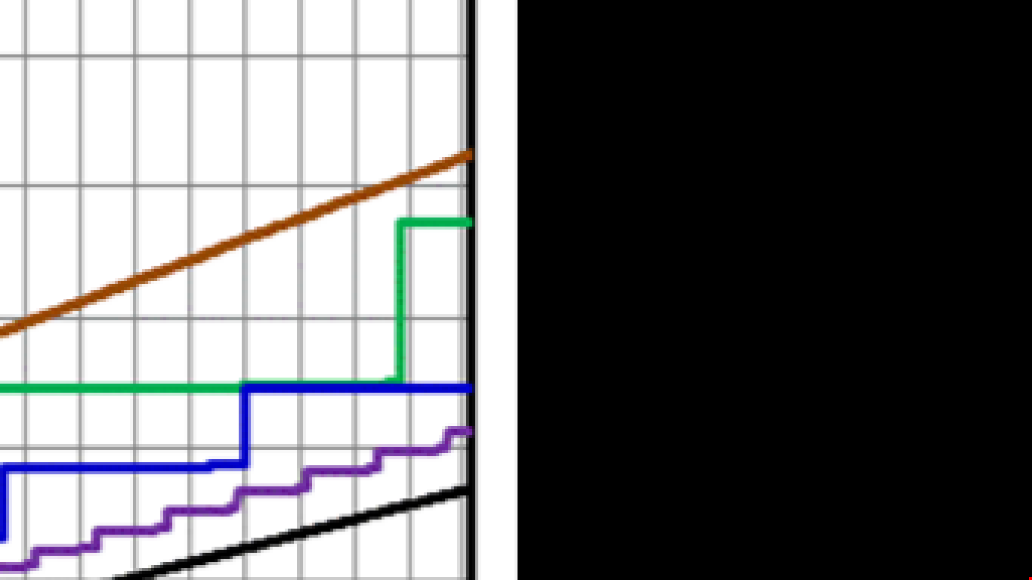
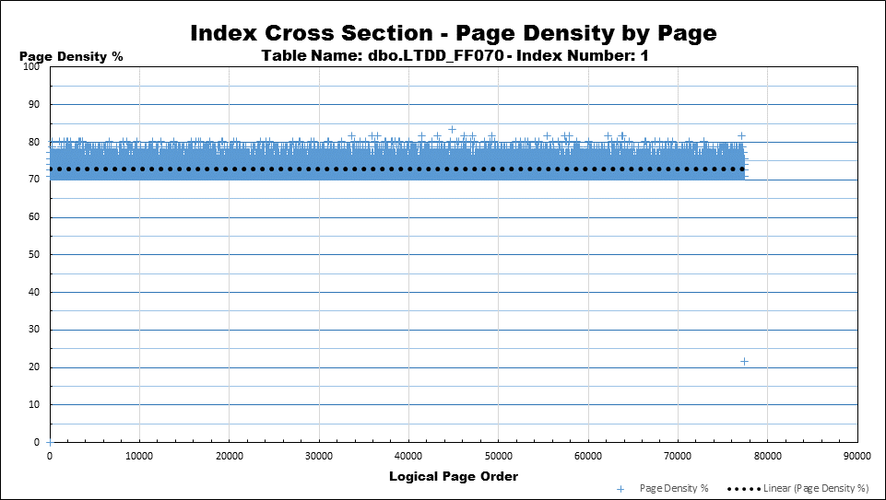
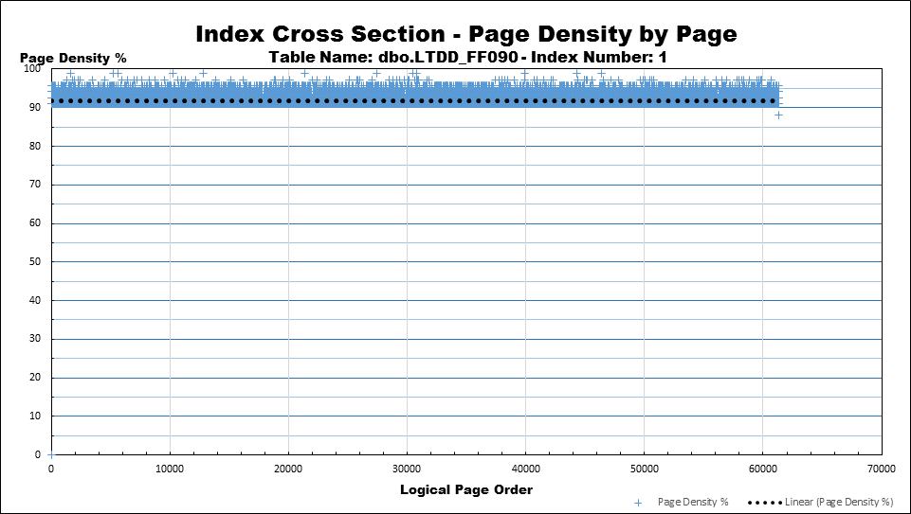
Low Threshold Rebuilds 70-80-90 Random GUID/Evenly Distributed
Ended about 8 days after rebuild
Ended just before rebuild
Ended about 3 days after rebuild

Slide 13
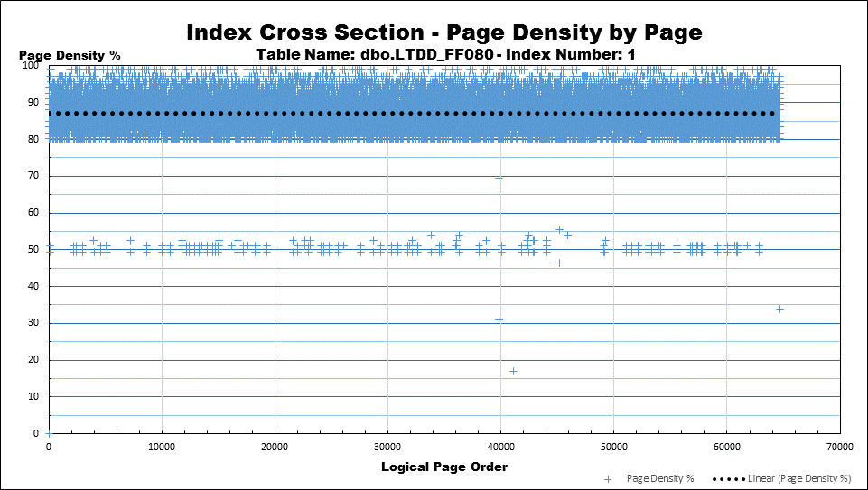
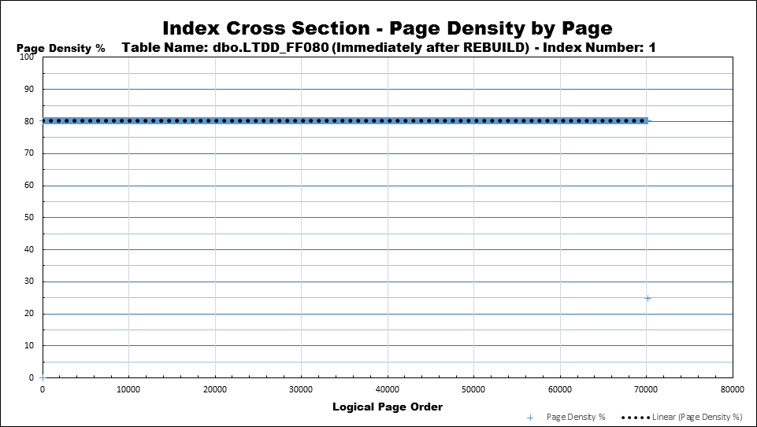
LTDD_FF080 Before and After Rebuild
Lots of Free Space to fill
(REORGANIZE DOES NOTHING TO HELP THIS SPACE!!!)
Only costs about 550 pages (4.3 MB) to be good for another 4-5 weeks with NO PAGE SPLITS/No Fragmentation and that space will be used!
Not quite 65,000 pages

Slide 14
How do we achieve such a miracle? (Repeat)
Identify the index as a GUID or mostly "Evenly Distributed" index.
Made 4 small changes in how it's defragmented.
Stopped Using Reorganize for this type of index. Only do REBUILDS!
Established a proper fill factor (ends with "1").
Rebuilt as soon as confirmed fragmentation starts to happen @ 1%.
Ran Index Maintenance every night.

Slide 15
The Hard Part Is…
How to determine if the index is an evenly or nearly evenly distributed index?
Get a hint from the leading column.
Hard to tell if the index is "evenly distributed" unless you "DNA" the individual page fullness and look at it.
Once determined, assign a FILL FACTOR that ends with "1" (71, 81, 91).

Slide 16
Insert "Patterns"
Real Life is More Cruel than GUIDs.

Slide 17
Importance of the "Insert Pattern"
Dictates what the FILL FACTOR should be.
Whether or not to even check for fragmentation.
Only yearly checks on 100% Fill Factor.
Only yearly or monthly checks on 99% Fill Factor.
Dictates WHEN to do defragmentation.
By checking Logical Fragmentation or…
By checking Physical Fragmentation

Slide 18
"Patterns" of Inserts to Indexes
6 Basic "Insert Patterns" of Indexes
RANDOM GUID or "Mostly Evenly Distributed".
Already Covered in 1st Session and beginning of this session.
"Static"/Nearly Static
"Append Only" or "Ever Increasing".
IDENTITY or Sequence
Some date based columns
NewSequentialIDs
Also has some nasty caveates
"Siloed"
Similar to "Mostly Evenly Distributed" but has some nasty caveats.
Names, Locations, Phone #'s, etc
"Unknown"
Delete/Insert (not covered)

Slide 19
Static/Mostly Static

Slide 20
Static/Mostly Static Indexes
Reference Tables.
Read Only/Static Tables.
Never or almost never change.
Verify with sys.dm_db_index_usage_stats.
No updates after 4 weeks is a pretty good indication of a Read Only/Static table.
Build at 100% Fill Factor
If inserts or updates are occasionally used, rebuild to 100% if "Bad" page splits occurred during the modification.
They should almost never need index maintenance.

Slide 21
"Append Only" Indexes

Slide 22
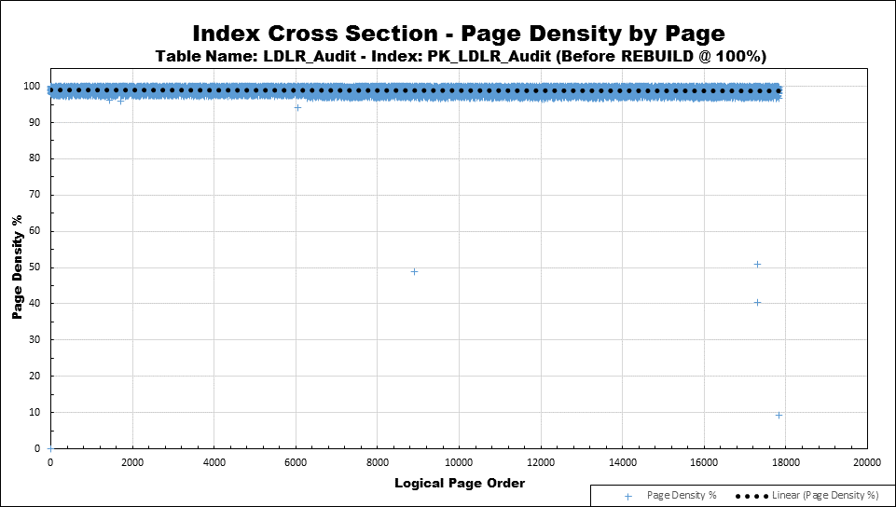

"Append Only" Clustered Index
More than 4.5 years old.
Never defragged.
New data always added at logical end.

Slide 23
"Append Only" Indexes
Almost the same as "Static".
No "Bad" Page Splits.
(Almost) No Logical Fragmentation.
No Physical Fragmentation.
Unless you do DELETEs/
Build with 99% FILL FACTOR.
Just to identify them as something other than "Static" or "Unknown" indexes.
Almost never needs defragging.

Slide 24
"Siloed" Indexes

Slide 25
Introduction to "Siloed" Indexes
"Mid-Index" inserts can cause "Siloed" indexes.
A "Silo" is a "hot spot" of inserts somewhere in the middle of the index.
There are two sub-types of "Siloed" indexes:
"Random Silos"
"Sequential Silos"

Slide 26
"Random Siloed" Indexes
One of the worst things that can happen to an index

Slide 27
"Random Silo" Index
Inserts are done out of order within the "Silo"…
Causes lots of "Bad" page splits…
Serious Logical Fragmentation…
Serious Physical Fragmentation…
Incredibly low Page Density within the "Silo".
Unless you catch them in time!
Many Non-Clustered indexes fall into this category.
Should NEVER allow this to occur in a Clustered Index.

Slide 28
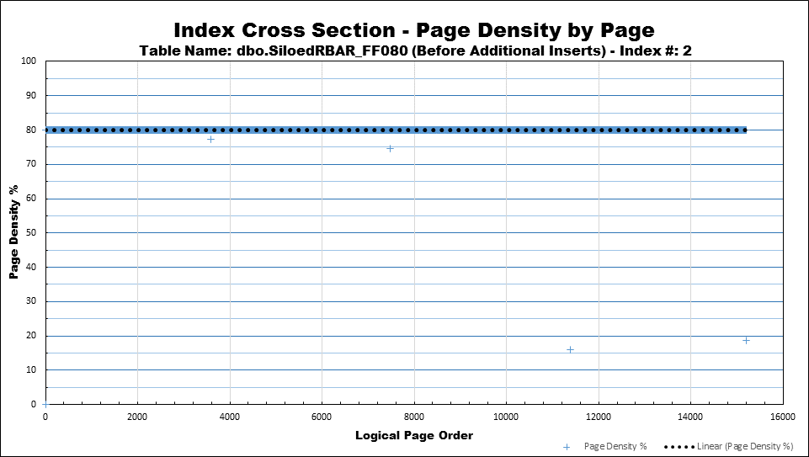
Non-Clustered After Rebuild 80% Fill Factor
HINT: If the Rebuild matched or exceeded the FILL FACTOR, then the Rebuild worked!
If not, then the row widths are wonky (horrible mix or simply too long) and the index may be "Permanently Fragmented" or simply be too small to defragment.
Not an "Outlier". Just a partially full page and logical end of index.
"Outliers" are NOT the cause of non-zero fragmentation.

Slide 29
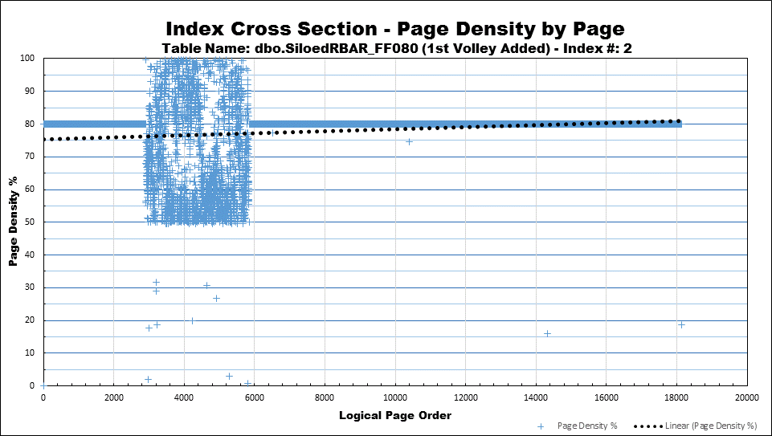
RBAR Populated Silos (600 K Out of Order Rows Added )
600,000 out of order rows added by RBAR in near proximity to each other.
Anything below the "Fill Factor" is because of a "Bad" Page Splits
Similar to using names or client numbers or zip codes, etc.
Is it worth REORGANIZING instead of REBUILDING?

Slide 30
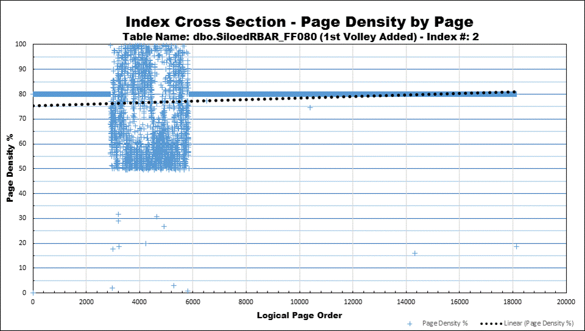
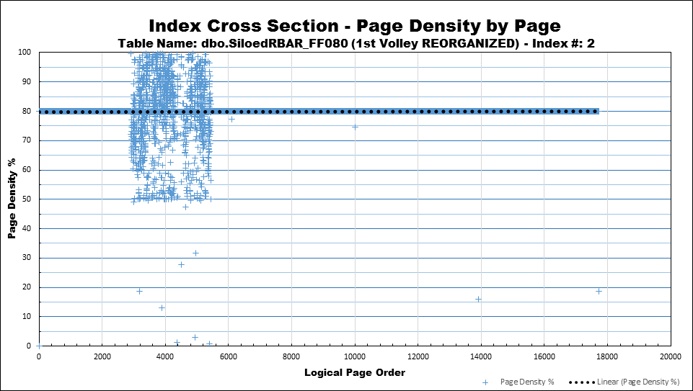
Here's What REORGANIZE Does
REORGANIZE took 29 seconds and we got very little for our efforts.
Watch this area. Almost nothing happens.
Watch this area. Freespace is removed.
Starting to look like "Evenly Distributed" or "NoDefrag".
Could also be caused by "ExpAnsive" updates.
This is a hint that something is wrong in this index because it's less than the Fill Factor.

Slide 31
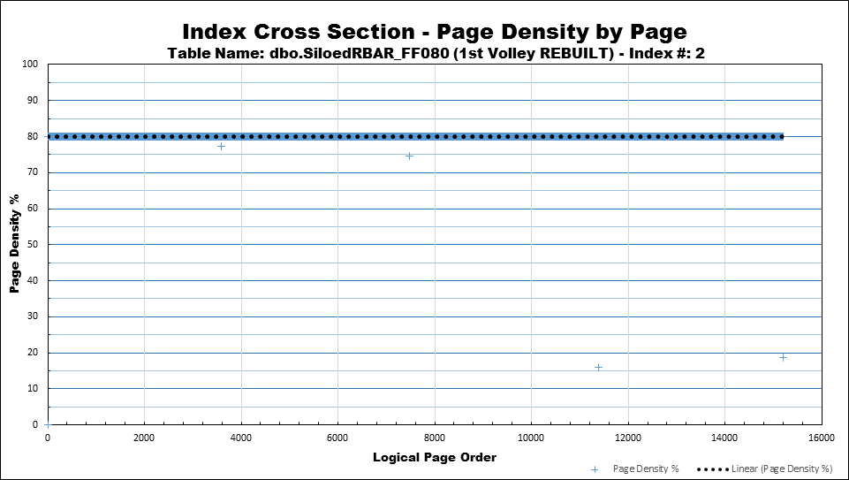
Here's What Rebuild Does
Lots of Free Space to fill
(REORGANIZE DOES NOTHING TO HELP THIS SPACE!!!)
3 seconds instead of 29
(almost 10 times faster than Reorg)
Less Disk Space
Less Log Space (Bulk-Logged Recovery)
Less Memory
Less Fragmentation
Fewer Future Page Splits

Slide 32
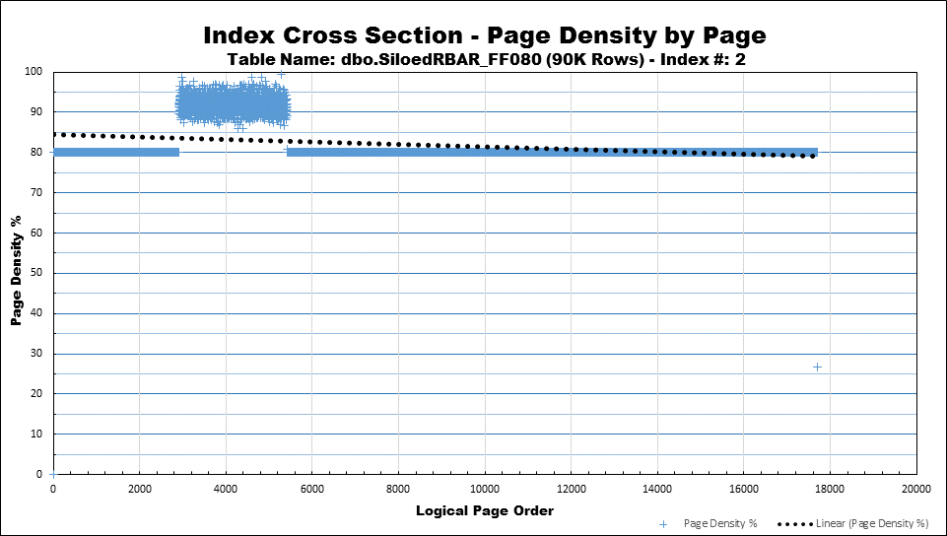
Add 10K Out-of-Order Rows at a Time
9 Days at 10K rows each
90,000 rows
No Page Splits

Slide 33
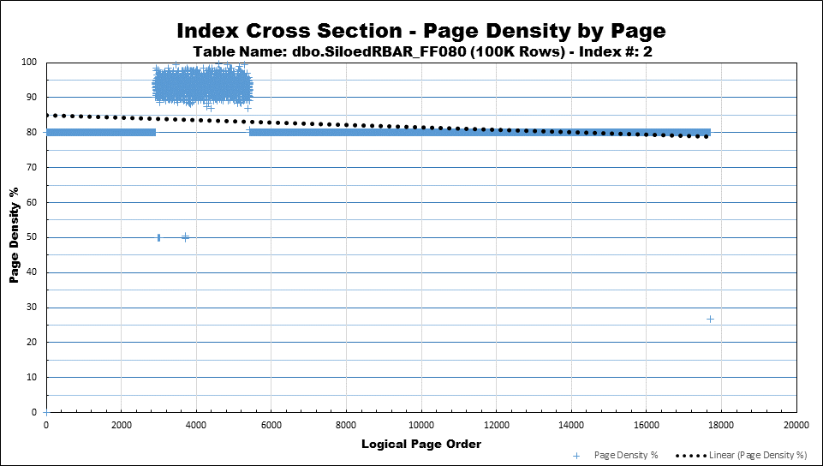
Add 10K Out-of-Order Rows at a Time
10 Days at 10K rows each
100,000 rows
Page Splits Start
Page Density is
INCREASING!

Slide 34
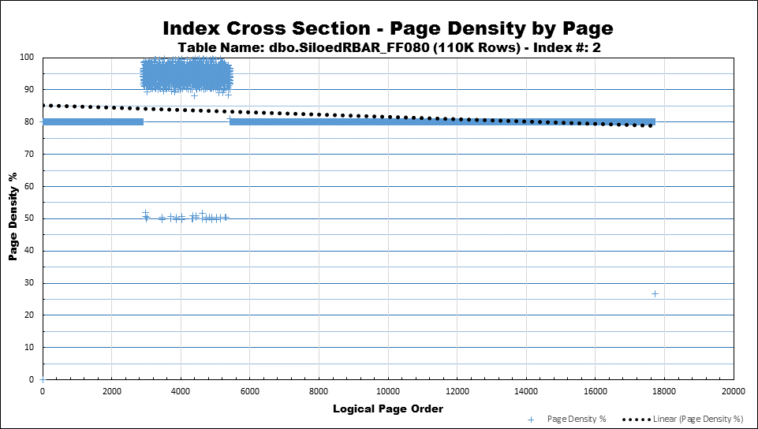
Add 10K Out-of-Order Rows at a Time
11 Days at 10K rows each
110,000 rows
13 Page Splits
Page Density is
about the same.

Slide 35
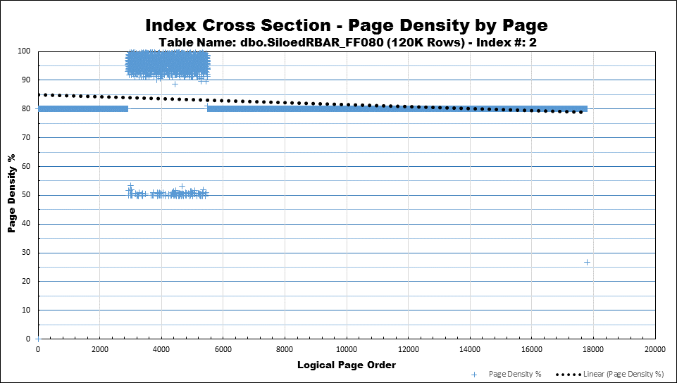
Add 10K Out-of-Order Rows at a Time
12 Days at 10K rows each
120,000 rows
67 Page Splits
Just coming up on 1%
Page Density is
INCREASING!

Slide 36

Add 10K Out-of-Order Rows at a Time
13 Days at 10K rows each
130,000 rows
214 Page Splits
Time to REBUILD
According to 1% Rule
Page Density is
DEcreasing!

Slide 37
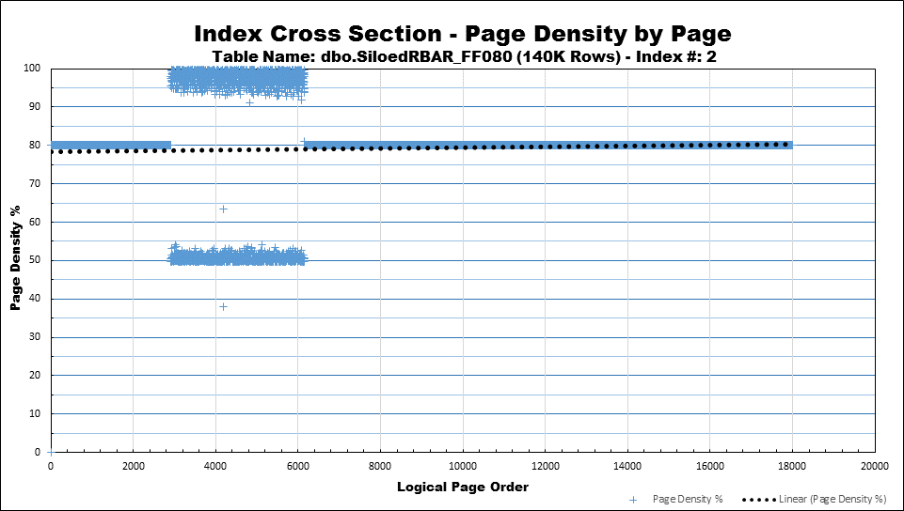
Add 10K Out-of-Order Rows at a Time
14 Days at 10K rows each
140,000 rows
444 Page Splits
That means we have 444 new pages and 888 pages that are only 50% full.
Hasn't reached 10% yet so no REORG yet.
Page Density is
DEcreasing!

Slide 38
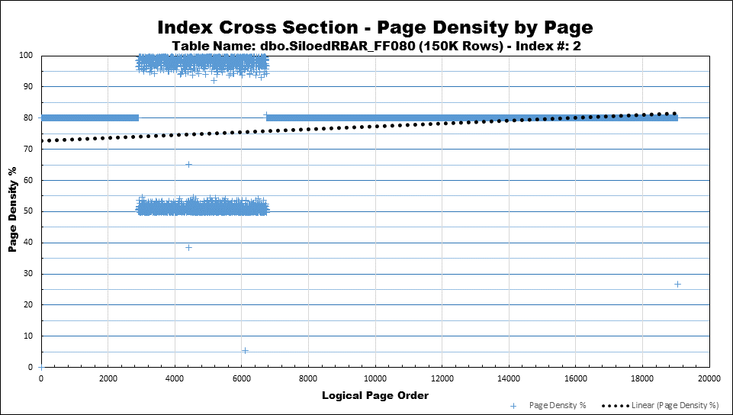
Add 10K Out-of-Order Rows at a Time
15 Days at 10K rows each
150,000 rows
589 Page Splits
That means we have 589 new pages and 1,178 pages that are only 50% full.
If you have the memory, set to 71, 81, or 91% and Rebuild at 1% frag.
10% Rule Waits Too Long. A lot of damage has already happened.

Slide 39
If the Insert Pattern Never Changes… (Tough Decision)
Wasted
Memory
Wasted
Memory
If limited memory, set to 97% and REBUILD if page density drops below 90% or so.
You might be trading more page splits for less wasted memory.
BUT, if those 97% area's aren't read into memory, then there is no waste. Tough decision.

Slide 40
If we were to REORGANIZE…
And these would stay and continue to split.
To here…
Most of these pages would move from here…

Slide 41
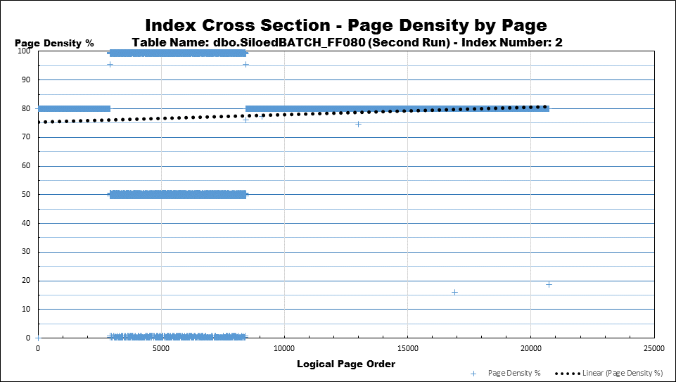
Secondary Batch Insert of Sequential Values
Due to "Skewed" Page Splits.
Very low Page Density within the Silo.
Not much you can do with this type of index.
Set FILL FACTOR
to 97% to save memory (can't prevent splits here).

Slide 42
"Sequential Siloed" Indexes

Slide 43
"Sequential Siloed" Index
If the inserts are done in order within the "Silo" …
Little or No Physical Fragmentation.
Looks like and mostly works like an "Append Only" insert pattern.
SURPRISE! Can be 99% Logically fragmented.

Slide 44
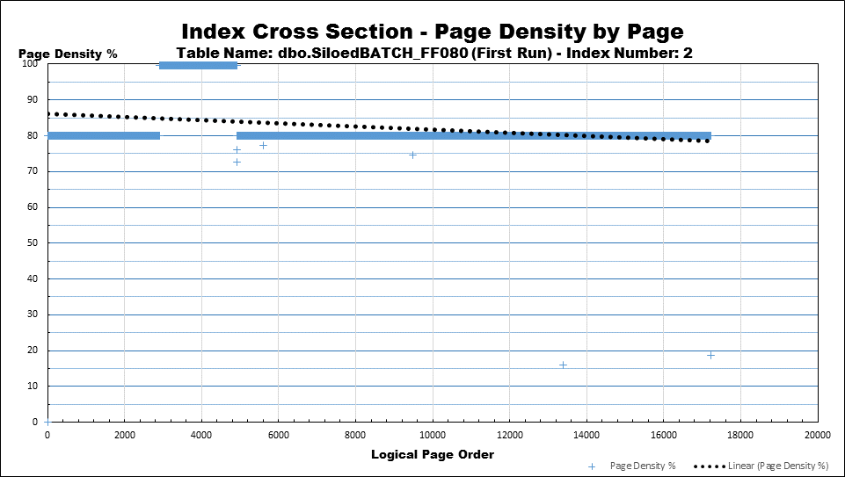
What's This?
Is this "Siloed" or…
…Is it "Ever Increasing"?
Also PROVES that INSERTs are NOT affected by FILL FACTOR. They ALWAYS try to fill to 100%.
It's actually an Ever Increasing "Single Sequential Silo"
It's a NewSequentialID after a restart.
80% Fill Factor just so it would show up. Stupid to do so. Should be 98%

Slide 45
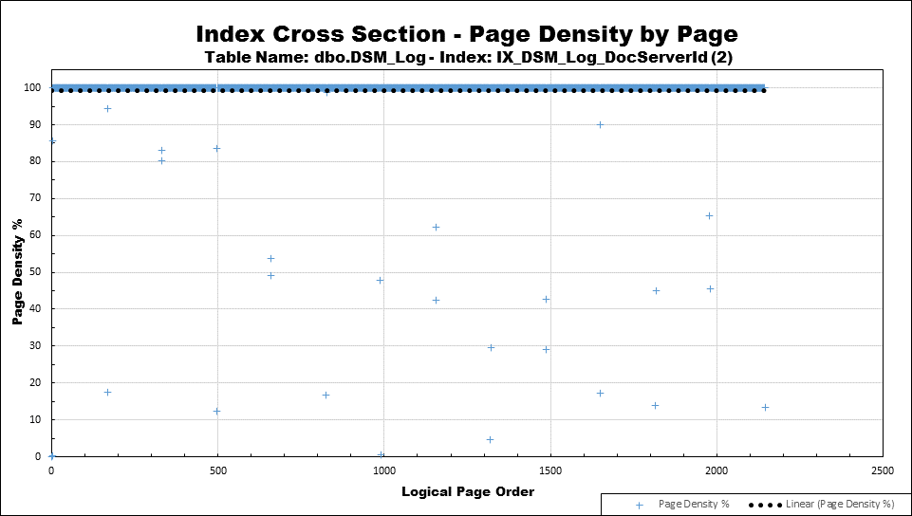
Another "Sequential Silo" Index
13 Separate Insertion Points for 13 Sections of Ever-Increasing Data

Slide 46
Another "Sequential Silo" Index
Based on "ServerID" for 13 Servers.
Clustered Index on table is based on IDENTITY column called DSM_Log_ID (automatically appended to NCI), which provides the "Sequencialness" for each section .
Like 13 small tables with "Ever Increasing" indexes.
Set FILL FACTOR to 98 to differentiate from Static table or Append Only table.

Slide 47
"Unknown" Indexes

Slide 48
"Unknown" Indexes
Indexes with a "0" FILL FACTOR.
Same as "100%" FILL FACTOR.
STOP DOING INDEX MAINTENANCE ON THESE BECAUSE YOU DON'T KNOW WHAT TYPE OF INDEX IT IS NOR WHAT WILL HAPPEN IF YOU REBUILD.
What if their Page Density is really low?

Slide 49
What to do with Low Page Density "Unknown Indexes"
Check indexes that have a "0" Fill Factor for Page Density.
If Page Density <= 82%, REBUILD at 82%.
If Page Density > 82% and <= 92%, REBUILD at 92%.
Otherwise, leave them alone and stop doing index maintenance on them.
The "2" in the Fill Factor indicates that you still have "to do" more analysis on the index but rebuilt the index just to save some space. You should get to these "someday".
Index could still be wasting a lot of memory.
Index could still be suffering from a lot of page splits.

Slide 50
"ExpAnsive" Updates
The Answer to the Question of…
"Why do my indexes fragment so FAST???

Slide 51
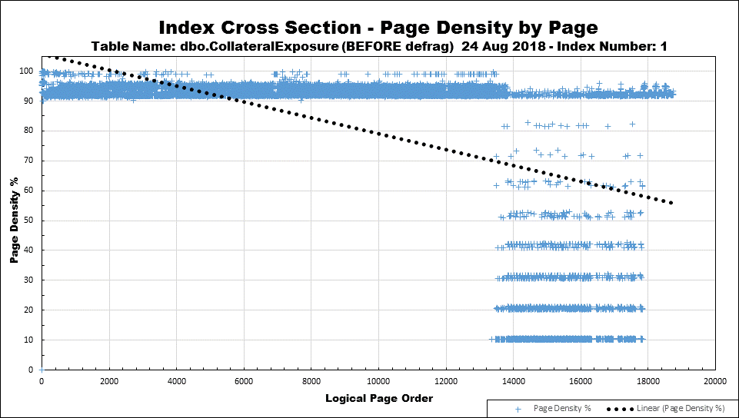
Effect of ExpAnsive Updates on "Append Only" Indexes
Inactive area would make this too expensive (wasted memory) to REBUILD at a 70 or 80% FILL FACTOR. (149 Million Rows in table)
Inserted and then updated.
ExpAnsive columns like "Modified_By" make existing rows no longer fit on their current page.

Slide 52
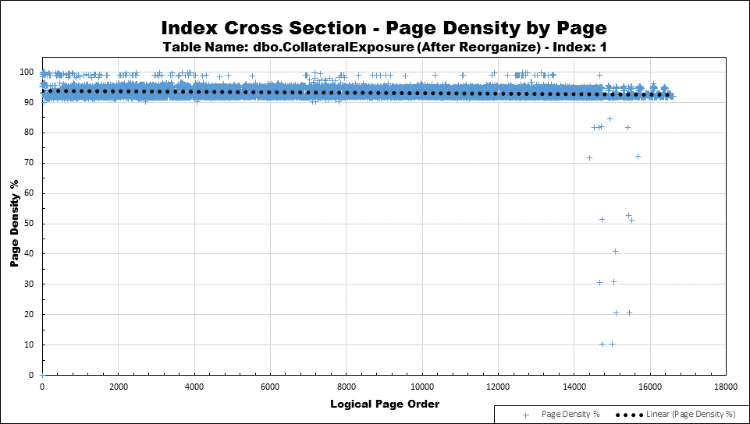
After REORGANIZE
Holy Quackin' Ducks, Batman!
Have we found a place where REORGANIZE is good???

Slide 53

Cost of REORGANIZE
01:20:45 Duration (hh:mi:ss)
Log file EXPLOSION!!!
Log file grew from ~20GB to 227GB!
Backup duration jumped from < 2 minutes to > 25 minutes twice!
Compressed backup size jumped from normal ~40MB to…
8GB followed by …
25 GB followed by …
Another 25GB followed by …
7GB
Rebuild of stats: 00:01:18
AND, I had to shrink the log file for restorability.
NOT exactly "more lightweight and less resource intensive" than REBUILD.

Slide 54
Cost of REBUILD
In BULK-Logged Recovery Model
00:12:44 Duration (hh:mi:ss)
Almost 7 times faster than REORGANIZE!
Regular maintenance comes in at about 6 minutes or 14 times faster than REORG!
Log File Usage
Grew from ~20GB to 37GB (190GB less than REORG)!
Backup duration 22 minutes one time.
Less than half of REORG!
One compressed backup of 23.5GB.
Less than half of REORG!

Slide 55
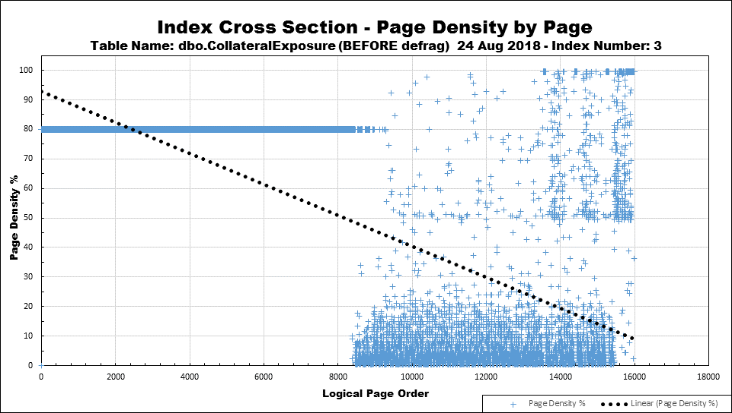
Effect of ExpAnsive Updates on "Append Only" Indexes
Even more devastating on narrower non-clustered indexes.
What do you think the page density is in the Silos???

Slide 56
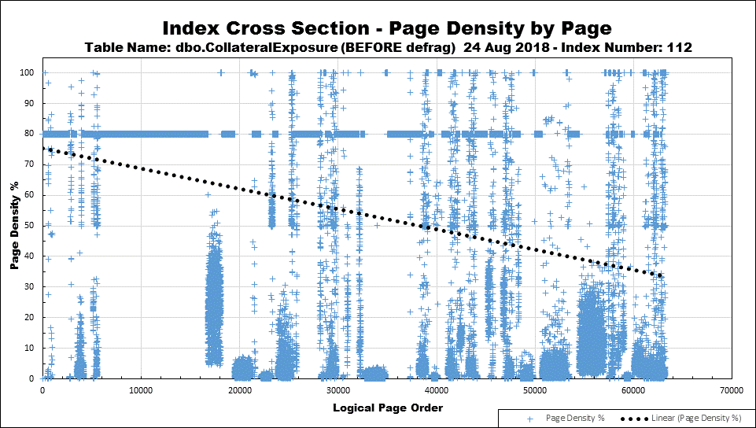
Siloed/ExpAnsive Updates
Super low Page Density in the most used silos
wastes a large amount of memory.
Just barely qualified for defrag according to "Best Practices".
We can save nearly 30% on memory if we rebuild more often, BUT…
But look at the Page Density! We waited way too long!

Slide 57
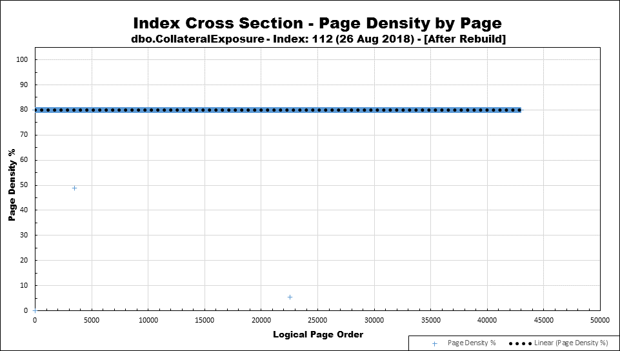
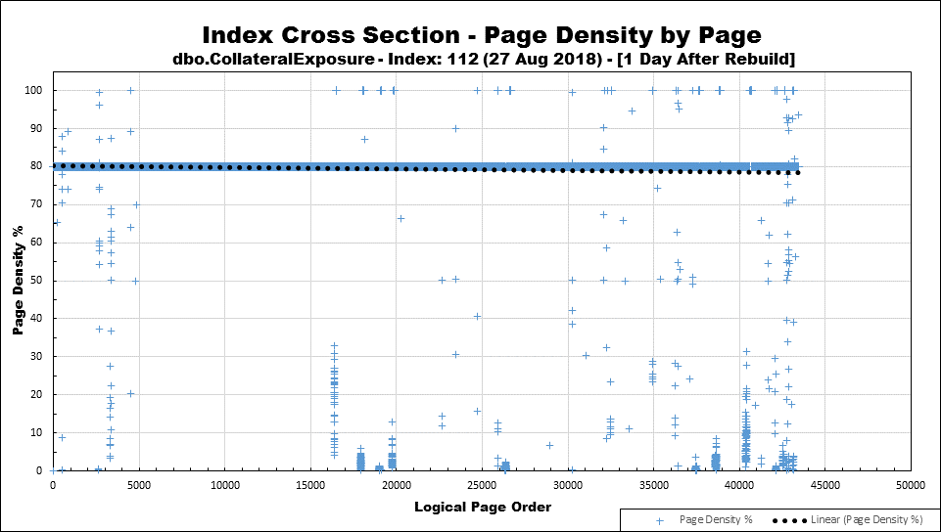
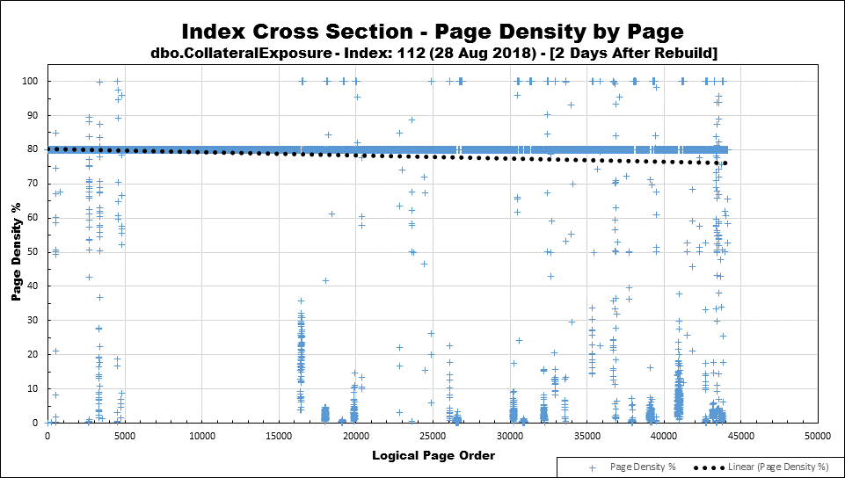
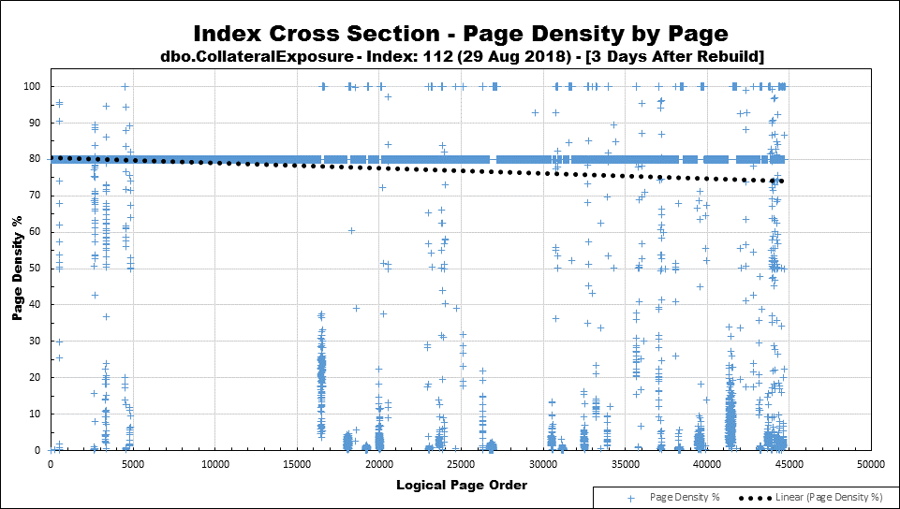
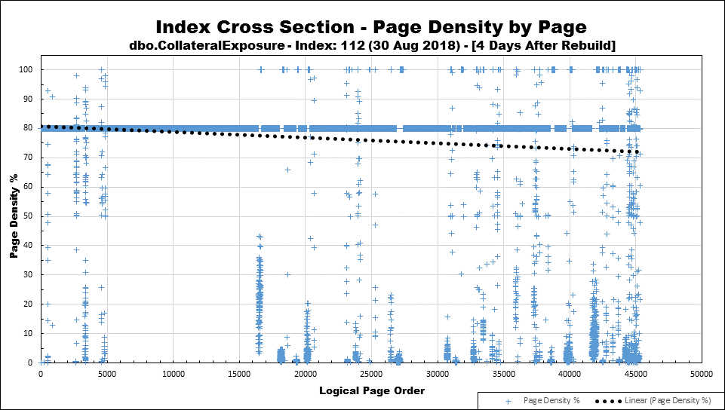
Effect of ExpAnsive Updates on "Siloed" Indexes (Over just 4 days)
The FILL FACTOR isn't helping much.
Don't forget…
Most of our NCIs are "Siloed" Indexes
"ExpAnsive" Updates are the killer here.

Slide 58
The Bottom Line…
"ExpAnsive" UPDATEs kill your best laid plans for…
Prevention of Fragmentation
Index Maintenance
Effective Memory usage
Reading as few pages as possible
As you come across them, they need to be fixed, especially on big indexes.
Please see "Extras" at the end of the presentation for suggestions on how to fix them.

Slide 59
Rules Started Forming
… and My Head Hurts

Slide 60
My First Realization
STOP USING REORGANIZE NOW!!!
Causes page splits to occur more quickly.
Removes critical free space from the index.
Does not add critical free space above the Fill Factor, where it's needed the most.
In many cases, it does little or nothing to fix Page Density nor prevents bad page splits.
Compared to REBUILD, it…
Causes massive log file "explosions" on larger indexes.
Cause lots of small "explosions" on smaller indexes.
Is significantly slower.
Yes, it's always "Online" and that's a part of the reason why it's slow and why people continue the mistake of using it.
Smaller indexes will seem ok but you're dying the "Death of a Thousand Cuts".

Slide 61
When to Use REORGANIZE
Only on tables that have LOB columns and…
Only if the LOB columns need to be "densified".
Only if it actually works.
Can still be incredibly useless on In-Row Data.
Sidebar Recommendation
Use the following command to force LOBs "out-of-row".
EXEC sp_tableoption 'SomeTableName', 'large value types out of row', 1;
Will have to do an "in-place" UPDATE to move existing LOBs then Rebuild the Clustered Index.

Slide 62
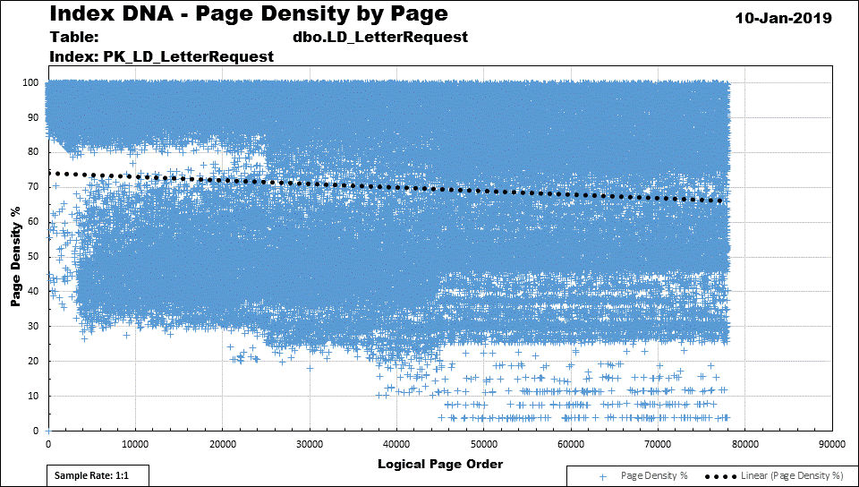
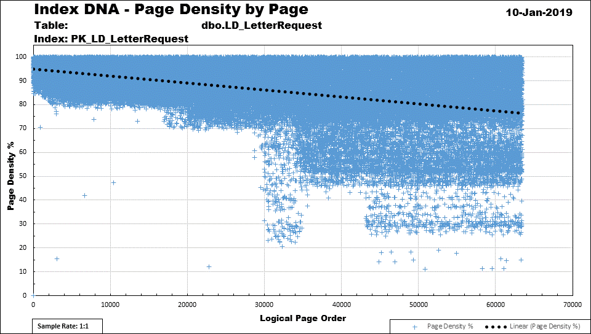
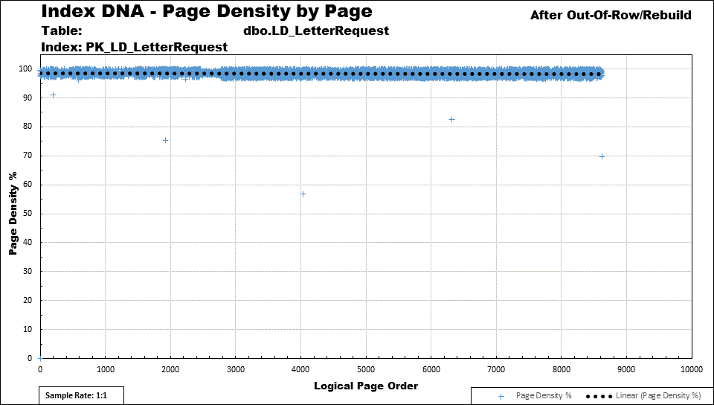
Effect of In-Row LOBs (XML Column, in this case)
Before any defragmentation
REORGANIZE did little to help.
Same with REBUILD.

Slide 63
Now, all you have to do is…
Determine the Insert/Update pattern and proper Fill Factor of…
Every Index
On every table
In every database
On every instance.
Yeah… I know what you're thinking…

Slide 64

… and so does this guy

Slide 65
Stop the Bleeding

Slide 66
Remember the 3 Goals
Prevent Page Splits whenever possible.
Due to Inserts and ExpAnsive Updates.
Avoidance Increases Performance
Inserts happen more quickly.
Fewer/shorter system transaction blocking of Selects.
Avoidance Decreases Log File usage.
Preserve Memory/Disk Space.
Make Read-Aheads faster when needed.

Slide 67
Let the Big Problems Identify Themselves!
Do what I did but don't wait as long…
Find what's suffering from lots of page splits and fix those first!
Script: 03 Find Page Splits in TLog Backups.sql (query)
Temporarily stop doing index maintenance for several weeks (month is good) and then…
Use the numbering tricks with Fill Factor to keep track of what kind of index you're dealing with and (only) rebuild accordingly.
Follow a plan.

Slide 68
Assign Fill Factors and Follow a REBUILD Plan
“Index Maintenance Guidelines” Jeff Moden/Ed Wagner - Rev 00 – 11 Jan 2019
Fill Factor to Assign | Index “Type” | When to Check | When to Rebuild and Notes (Never Reorganize)
100 | Static or nearly static Read Only, Reference tables, almost never written to. Sys.dm_db_index_usage_stats can really help find these. If you have no “user updates” for 30 days, usually a shoe-in. | Month, Quarter, or Year | >1% Logical Fragmentation
99 | Append Only / Ever Increasing Lead column is Identity, NewSequentialID, some dates/times, Sequences, etc, with near zero logical fragmentation and very high page density. Again, sys.dm_db_index_usage_stats will separate these from 100% because there will be “user updates”. | Month, Quarter, or Year | >1% Logical Fragmentation
98 | Sequential Silos Usually single column NCI where related CI is Ever Increasing. High logical fragmentation but also has very high page density (usually >95%). Use sys.dm_db_index_physical_stats to find. | Daily | >XX% Logical Fragmentation May have to analyze the daily workload for what XX% should be but a good place to start is 10%.
97 | Append Only with “ExpAnsive” Updates Usually Ever Increasing CI with fragmentation but could be an NCI, as well. Try to fix these but, if you can’t, keep at 97 so you know what they are. Never label as “Hopeless” even if they are. | Daily | >XX% Logical Fragmentation OR Page Density < (Fill Factor – XX) May have to analyze the daily workload for what XX% should be but a good place to start is 10%. Remember, we’re usually trying to save on memory here because the page splits cannot be prevented.
Ends with “2” (Usually 82 or 92) | Unknown but needed to recover disk space The “2” stands for “TO DO” and you need to analyze these someday. If BIG, analyze ASAP! | Daily | >XX% Logical Fragmentation OR Page Density < (Fill Factor – XX) May have to analyze the daily workload for what XX should be but a good place to start is 10 for both types of fragmentation.
Ends with “1” (usually 71, 81, or 91) | Evenly Distributed Typically, the leading column is a Random GUID. Very little else is truly “Evenly Distributed”. Note that NEWSEQUENTIALID is NOT “Evenly Distributed”. It’s actually a “Sequential Silo” (98%). | Daily | >1% Logical Fragmentation May have to analyze which Fill Factor to use (all end with “1”) to achieve prolonged periods with zero fragmentation but should always rebuild when logical fragmentation is greater than 1%, which is where bad page splits start in earnest.
Ends with “0” (except for 100 and 0. Usually 80 or 90.) | Random Silos and Hopeless (permanently fragmented) Manually assigned as “Hopeless” such as random or “Out of Order Silos” and unfixable ExpAnsive Updates where rampant logical and physical fragmentation can’t be slowed down and fits none of the other Fill Factors. Make sure these don’t fit other Fill Factor requirements, especially 97%. | Daily | >XX% Logical Fragmentation OR Page Density < (Fill Factor – XX) May have to analyze the daily workload for what XX should be but a good place to start is 10 for both types of fragmentation. Need to analyze what the Fill Factor should be to minimize splits if possible and save memory if can’t minimize splits.
0 | Default/Unknown Never defrag as “0”. If need to recover space but haven’t figured out the type of index required, use a Fill Factor that ends with “2” to mark it as “To Do”. | Once Each | Assign a Fill Factor to these or leave them alone.

Slide 69
In the "Extras"
Suggestions for fixing ExpAnsive Updates
How to identify
Changing data-types
Using wide defaults
Using partitioning
Forcing "Out of Row" for LOBs and wider variable width columns.
How to Rebuild large indexes without blowing out the MDF or LDF files.
Tons of References

Slide 70
Q’n’A

Slide 71
"Black Arts" Index Maintenance #2
Better Methods that Can Actually Prevent Fragmentation for Weeks
Jeff Moden
Thank you for attending ~ and ~ Thank you for what you do!

Slide 72
EXTRAS!!!

Slide 73
Fixing "ExpAnsive" Updates
First, get a hammer…

Slide 74


… A really BIG hammer!
BIG

Slide 75
Ok… Little hammers for little nails
Any variable width column 10 bytes or less should be CHAR() or NCHAR().
Don't forget that VARCHAR() and NVARCHAR() carry 2 bytes of overhead to identify column width, so there's some hidden savings.
Avoid NULLs if the column is variable width.
Provide a decent default.
Could use a number of spaces equal to the expected population for the default.
Populating with real data that is smaller won't cause page splits… just a little wasted memory, if done right.
Consider a wider CHAR or NCHAR if the data is consistently larger and has little variation in width.
BE CAREFUL! There may be code that relies on comparisons for NULL! Should never allow that but it happens!

Slide 76
An Expansive Update Solved by Some Good Luck
CREATE TABLE dbo.VLR_SubscriptionPublicationQueue ( VLR_SubscriptionPublicationQueueID INT IDENTITY(1,1) NOT NULL, VLR_SubscriptionID INT NOT NULL, PublicationItemID INT NOT NULL, ActivityStatusCode CHAR(1) NOT NULL DEFAULT 'A', Created_By VARCHAR(50) NOT NULL DEFAULT ORIGINAL_LOGIN(), Created_Date DATETIME NOT NULL DEFAULT GETDATE(), Modified_By VARCHAR(50) NULL, Modified_Date DATETIME NULL, CONSTRAINT PK_VLR_SubscriptionPublicationQueue PRIMARY KEY CLUSTERED (VLR_SubscriptionPublicationQueueID ASC) );
Modified_BY was always about 48-50 characters, so…
The fix for this index was to change the Fill Factor to 99, change Modifed_By to CHAR(50), and REBUILD the Clustered Index manually one final time.
Will almost never become fragmented ever again and won't waste memory.
Could also default to 50 spaces to avoid data-type change. (BE CAREFUL!)
Created_By isn't a problem because it's never updated.
Causes ~66% Row Expansion

Slide 77
A Bigger Hammer, Partitioning
Latest month suffers Inserts and Expansive Updates.
Previous month suffers only Expansive Updates.
Other months are totally static.
Really needs multiple Fill Factors.
If large, good candidate for Partitioned View.
Possible redesign to fix Expansive Updates.

Slide 78
Going Hammerless
Set FILL FACTOR to 97 and rebuild only if the Page Density drops below some predetermined value.

Slide 79
The "Best" Hammer…
Change things like Modified_By to use a reference table with INTs.
Add a trigger to add a new value and INT to the reference table and add the INT to the table instead of a VARCHAR/NVARCHAR.

Slide 80
One way to check for Expansive Updates
If it's really important (for example, a huge table), temporarily add a trigger to the table to check for UPDATE.
Check only variable width data-types.
Compare lengths in INSERTED and DELETED logical tables to find the "ExpAnsive" Updates.
If lot's of columns, use dynamic SQL against sys.columns or INFORMATION_SCHEMA.COLUMNS view to produce the code for the trigger body.
Of course, write the comparison results to a table so you can see what's going on.
Script: 04 sp_CreateExpansiveUpdateTrigger.sql

Slide 81
Removing the Nail
If the column is almost always NULL, then do you REALLY need the column?
Move the expansive columns to a "Sister" table.
Will need an updatable view, though.
Set larger columns to a MAX data-type and force out of row with…
sp_tableoption 'schemaname.tablename' ,'large value types out of row', 1 ;
New data will live out of row.
Existing data must be updated to itself to be moved out of row.
Then rebuild the affected indexes.

Slide 82
How to Create or Rebuild Large Indexes
Without doubling space used in the MDF file!

Slide 83
For Non-Clustered Indexes (NCI)
When creating new NCIs, will not double space.
For Rebuilds, will typically double the space used (creates new, then drops old).
Disabling an index and then rebuilding it will prevent space doubling.
Major Caveat
Never disable an index that has the "Unique" property (used for FKs and unique constraint enforcement).
Check sys.indexes.is_unique to find out.
If cannot disable and it's a huge index, next page applies.

Slide 84
For Clustered Indexes (CI) and NCIs That Cannot Be Disabled
Creation of new CIs or Rebuilding existing CIs and non-disabled NCIs will always cause space doubling for the size of the index.
Almost NEVER disable a Clustered Index.
Will cause the data to NOT be available even if "ONLINE" option is used.
Will really mess up any FKs pointing at the table.

Slide 85
For Clustered Indexes (CI) and NCIs That Cannot Be Disabled (cont.)
Create a temporary file group and file either in free space on same drive as MDF or on another available drive.
I have a 1 TB "DBA ONLY" scratch drive for things like this thanks to a very understanding hardware team.
Use CREATE INDEX WITH DROP EXISTING to temporarily move the index to the temporary file group.
Rebuilds the index in the process.
Do the same thing to move it back to the original file group.
Will be a bit faster than the first move because the index is already defragged.
After making sure it was ALL successful, drop the temporary file and file-group.
If you don't have a "DBA ONLY" scratch drive, petition for one. It's an inexpensive thing to have that has many incredible uses. Make nothing permanent there.

Slide 86
Don't Wait for Page Splits to Happen
Don't use REORGANIZE routinely.
It doesn't create necessary free space.
It removes free space when needed the most and perpetuates page splits.
It runs a lot more often than you'd think.
Only use it to compress LOBs that actually need to be "defragged".
REBUILD at 1%
That's when page splits start in earnest.
Waiting for 10% is just waiting for a large number of page splits to happen.
Waiting for 10% also concentrates page splits.
It actually takes less time than current "Best Practices" and doesn't happen as often.

Slide 87
References

Slide 88
References Basics of Indexes
1. Table and Index Organization
https://technet.microsoft.com/en-us/library/ms189051(v=sql.105).aspx
2. Clustered Index Structures
https://technet.microsoft.com/en-us/library/ms177443(v=sql.105).aspx
3. Nonclustered Index Structures
https://technet.microsoft.com/en-us/library/ms177484(v=sql.105).aspx
4. Reorganize and Rebuild Indexes
https://docs.microsoft.com/en-us/sql/relational-databases/indexes/reorganize-and-rebuild-indexes

Slide 89
References Performance of Indexes
5. ** Definitive MS Article **
https://docs.microsoft.com/en-us/sql/relational-databases/system-dynamic-management-views/sys-dm-db-index-physical-stats-transact-sql
6. How Page Splits Affect the Transaction Log
https://www.sqlskills.com/blogs/paul/how-expensive-are-page-splits-in-terms-of-transaction-log/
7. Performance Considerations of FILL FACTOR
https://docs.microsoft.com/en-us/sql/relational-databases/indexes/specify-fill-factor-for-an-index

Slide 90
References Index Maintenance
8. Index and Stats Maintenance System
https://ola.hallengren.com/sql-server-index-and-statistics-maintenance.html
9. And they guy that started all this…
https://www.brentozar.com/archive/2012/08/sql-server-index-fragmentation/
https://www.brentozar.com/archive/2013/09/why-index-fragmentation-doesnt-matter-video/

Slide 91
More and Suggested Reading
https://www.sqlskills.com/blogs/paul/why-you-should-not-shrink-your-data-files/
https://www.sqlskills.com/blogs/paul/performance-issues-from-wasted-buffer-pool-memory/
https://www.sqlskills.com/blogs/paul/how-expensive-are-page-splits-in-terms-of-transaction-log/ ***
https://www.sqlskills.com/blogs/paul/clustered-or-nonclustered-index-on-a-random-guid/
https://www.sqlskills.com/blogs/kimberly/content/binary/indexesrightbalance-defrag.pdf?59c59e ***
https://www.sqlskills.com/blogs/paul/sqlskills-sql101-rebuild-vs-reorganize/
https://www.sqlskills.com/insidercontent/201505/20150511newsletter.pdf
https://www.sqlskills.com/blogs/jonathan/the-accidental-dba-day-14-of-30-index-maintenance/
https://www.sqlskills.com/blogs/paul/inside-the-storage-engine-anatomy-of-a-page/
https://www.sqlskills.com/blogs/paul/inside-the-storage-engine-anatomy-of-a-record/
https://www.sqlskills.com/blogs/paul/easy-automation-of-sql-server-database-maintenance/
https://www.sqlskills.com/blogs/paul/tracking-page-splits-using-the-transaction-log/
https://www.sqlskills.com/blogs/paul/performance-issues-from-wasted-buffer-pool-memory/
https://www.sqlskills.com/blogs/paul/index-rebuilds-depend-on-stats-which-are-updated-by-index-rebuilds/
https://www.sqlskills.com/blogs/paul/importance-of-index-maintenance/
https://www.sqlskills.com/blogs/paul/can-guid-cluster-keys-cause-non-clustered-index-fragmentation/
https://www.sqlskills.com/blogs/paul/a-sql-server-dba-myth-a-day-2530-fill-factor/
http://www.sqlskills.com/insidercontent/commonsqlservermyths.pdf
https://www.sqlskills.com/blogs/kimberly/the-clustered-index-debate-continues/
https://www.sqlskills.com/blogs/paul/conference-questions-pot-pourri-3-unexpected-index-rebuild-results-and-bulk-logged-operations/
https://www.sqlskills.com/blogs/paul/on-index-key-size-index-depth-and-performance/
https://www.sqlskills.com/blogs/paul/inside-the-storage-engine-proof-that-records-are-not-always-physically-stored-in-index-key-order/

